Slide 1
CSCE 623 In Class Day 14
Synchronous session

Slide 2
Agenda
Key points for Ensembles and Forests
Ensemble Model code exploration
Break
Questions & Project Discussion

Slide 3
Key Points for Ensembles and Forests
Ensemble Concepts
From Trees To Forests
Bagging
Decorrelating
Boosting

Slide 4
Ensemble Concepts
Weak Learner: model that performs (slightly) better than chance
Weak Learner Theory:
The vote of a set of (uncorrelated) weak learners is likely to be better than the performance of any individual weak learner model
Ensemble Model:
A set of models for which a mechanism exists to interpret the collective results of the individual models to answer a ML question

Slide 5
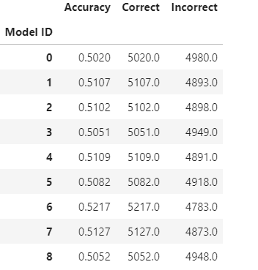
Ensemble Learning - Code Exploration
Obtain the code from Canvas
Instructor Overview / Description of Task
Breakout Groups to work on coding (10 min)
Share your results
Vote
Higher Accuracy!

Slide 6
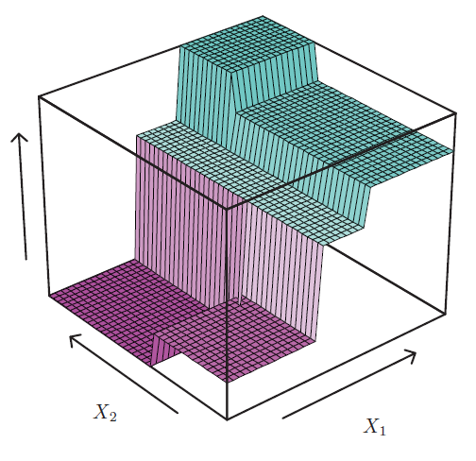
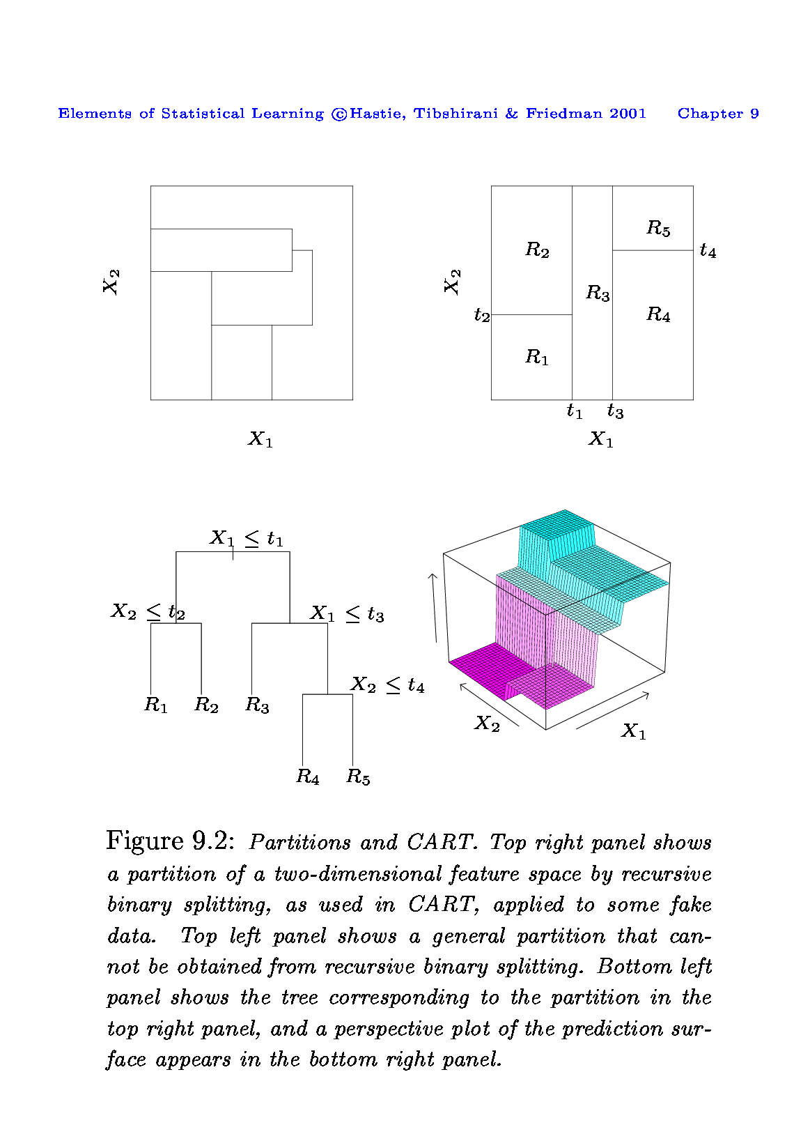
Remember Decision Trees?
R₅
R₄
R₃
R₂
R₁
Converts a ML task (classification; regression) into answering a series of questions about the values of individual features
Makes predictions based on the answers to those questions

Slide 7
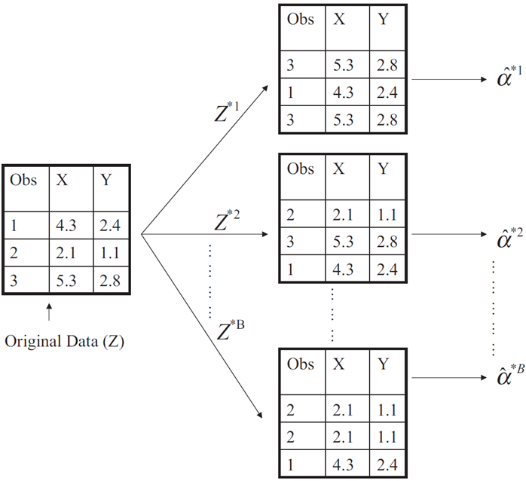
Remember Bootstrap? Bagging = Bootstrap Aggregation
Bagging is an extremely powerful idea based on two things:
Bootstrapping: generate many alternative training datasets
Averaging: reduce variance
Why does averaging reduce variance?
Averaging a set of observations reduces variance. Recall that given a set of n independent observations Z₁, …, Z_{n}, each with variance , the variance of the mean of the observations is given by
The larger the set, the tighter the estimate of the mean

Slide 8
Bagging is a technique for any model (not just trees)
Generate B different bootstrapped training datasets
Train the model separately on each of the B training datasets, to obtain B different models -> create the ensemble
Average (or vote) to determine the predictions of the ensemble
Problem: very strong / important features can lead many models to look alike (highly correlated)
Averaging many highly-correlated models means the power of ensembles might not be fulfilled

Slide 9
Randomizing feature subsets
A very efficient statistical learning method
Builds on the idea of bagging, but it provides an improvement because it de-correlates the models
How does it work?
General Concept: Build multiple models on a bootstrapped training sample, but when building these models, in each model, use a random subsample of m features from the full set of p features for the models
If growing decision trees, each split of the tree can use a different subset of features

Slide 10
Random Forests
Decision Trees plus Bagging plus random feature subsets per split to grow an ensemble of decorrelated trees
Good ensemble performance
Variants:
Boosting: Build the next tree in the forest to account for the error from the previous members in the forest
Boosted Stumps: Depth-1 random forest with boosting
More code examples (HOML chapter )7
https://github.com/ageron/handson-ml2/blob/master/07_ensemble_learning_and_random_forests.ipynb

Slide 11
Break

Slide 12
Questions & Open Project Discussion

